Slide 1


Getting Started With
Microsoft Access
Database
10
Manager of Information Center
Tendering Department
Arab Contractors
Said Fawzy

Slide 2
Getting Started With
Microsoft Access
Database
10
Advanced Query Topics
Manager of Information Center
Tendering Department
Arab Contractors
Said Fawzy

Slide 3

1
Types of Joints
Controlling Query Results with Join Types
2
3
Query Criteria

Slide 4
Creating Complex Queries with Multiple Criteria
4
Using Expression Builder & Zoom Window
5
6
Expression Syntax

Slide 5
7
Concatenate Fields in Query
Summarizing and Grouping Data Using Query
8
Using Where and Having in Grouping
9

Slide 6
Types of Joints

Slide 7



Slide 8

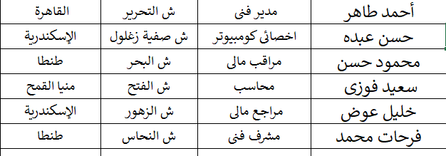
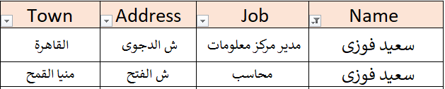
Emp
بيانات سعيد فوزى

Slide 9
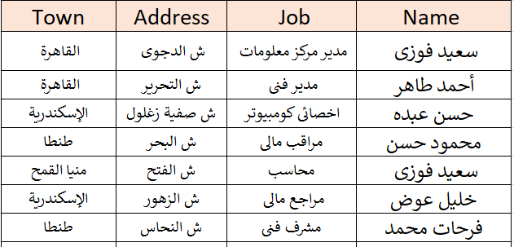
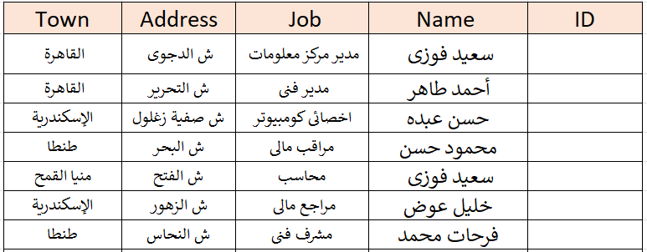
Constraints
Emp
PK
INSERT
Required
UPDATE
Unique

Slide 10

Constraints
Emp
PK
INSERT
Required
UPDATE
Unique

Slide 11
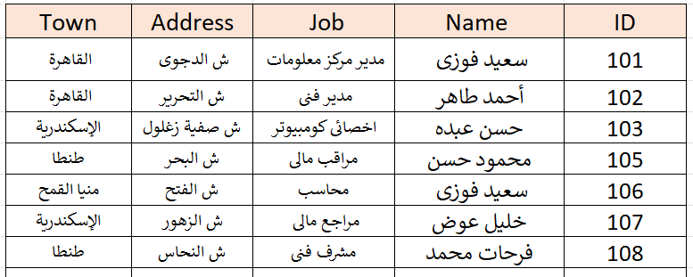
Emp
INSERT

Slide 12

Emp
INSERT

Slide 13
Emp
INSERT

Slide 14
Emp
INSERT

Slide 15
Emp
INSERT

Slide 16
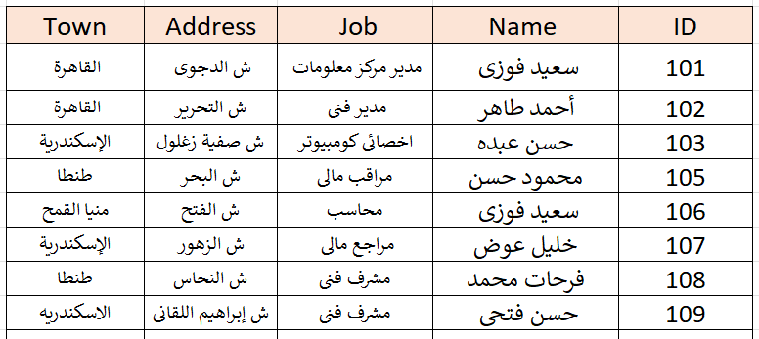


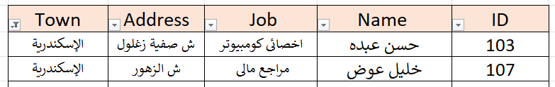
Emp
الإسكندرية

Slide 17
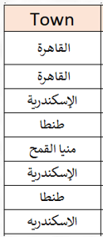
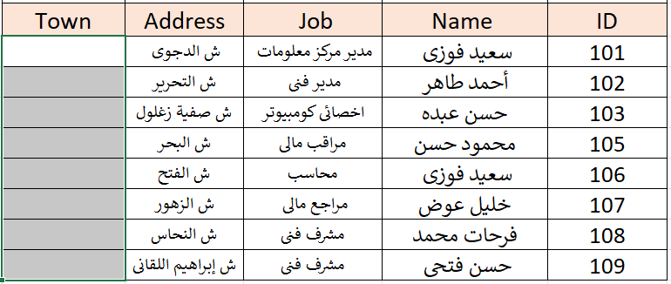
Emp

Slide 18
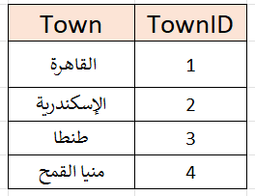
Emp
Towns

Slide 19
Constraints
Emp
Towns
PK
Required
Unique

Slide 20

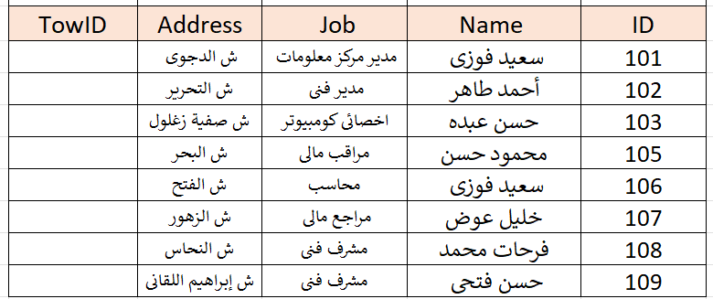
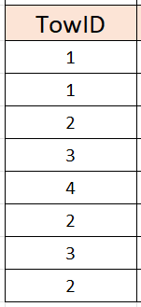
Emp
Towns
FK
PK
INSERT
Constraints
UPDATE
DELETE

Slide 21
Emp
Towns
FK
PK
INSERT
Constraints
UPDATE
DELETE

Slide 22
Emp
Towns

Slide 23
Emp
Towns

Slide 24
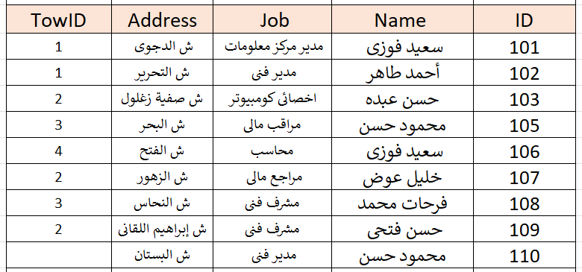
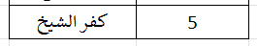
Emp
Towns

Slide 25
Emp
Towns
DELETE
We have no Orphans

Slide 26
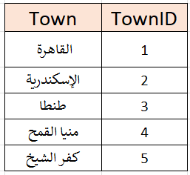
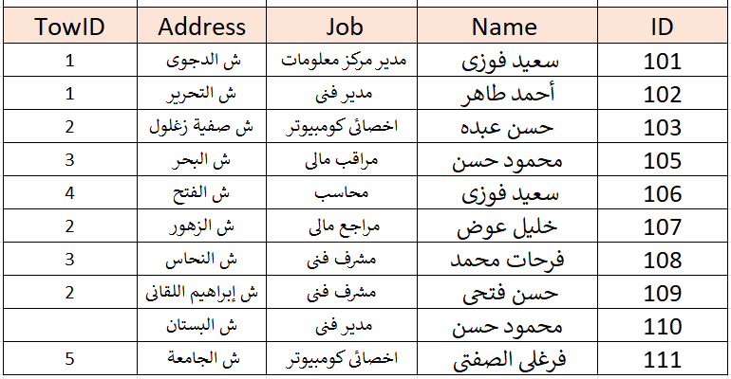

Towns
1
Emp

Slide 27
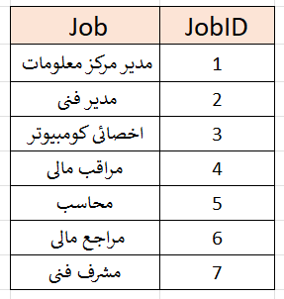
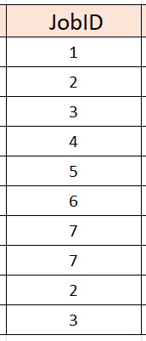
Towns
Jobs
1
1
Emp

Slide 28
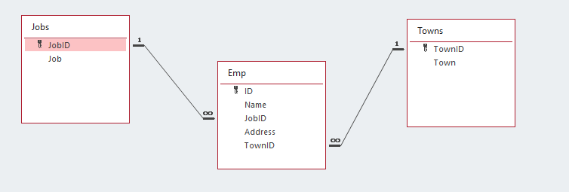

Slide 29
Towns
Jobs
1
1
Emp
How to retrieve data ?

Slide 30
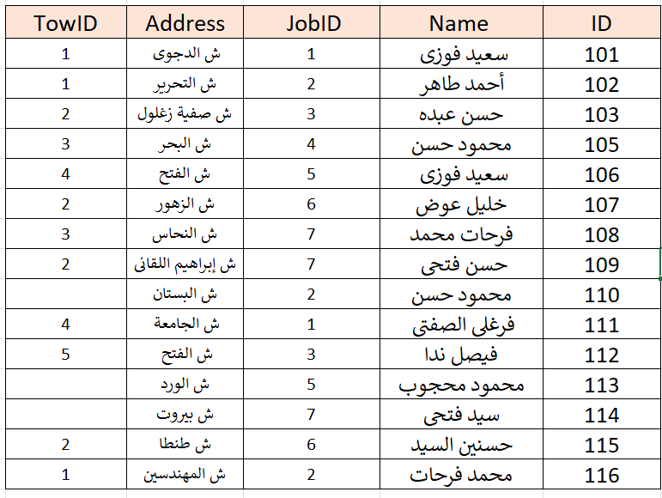
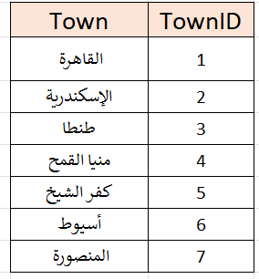
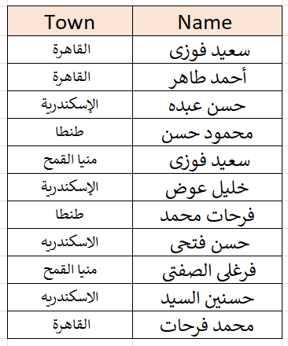
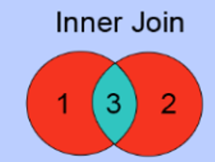
الاسم والبلد
المشترك فقط

Slide 31
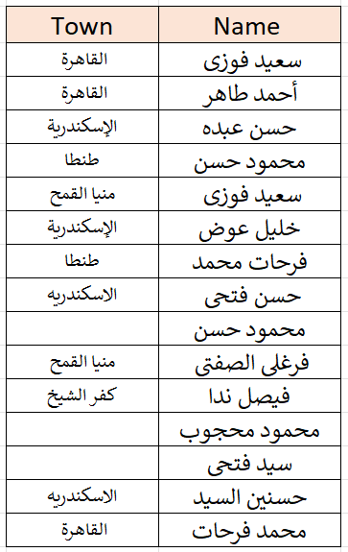
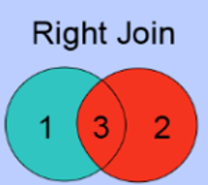
الاسم والبلد
كل الأسماء

Slide 32
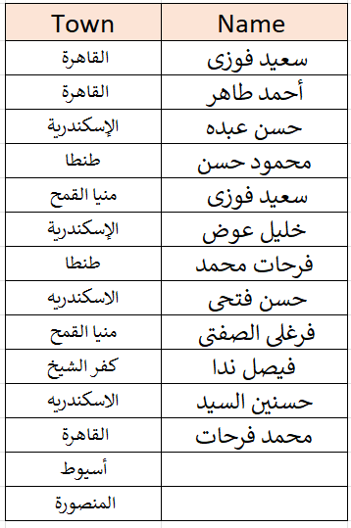
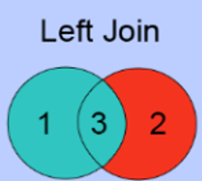
الاسم والبلد
كل البلاد

Slide 33
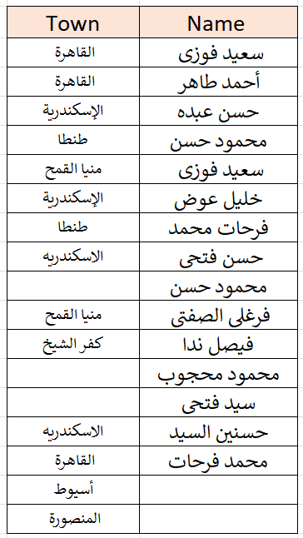
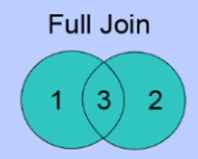
الاسم والبلد
كله كله

Slide 34
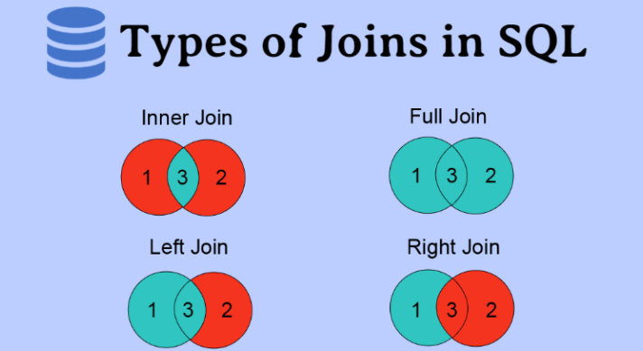


Slide 35
1. Inner Join
In an inner join, we only select the data which is common in both the tables. (ie, part 3 here)
In order to make it more precise, all the records from both the tables matching up the condition mentioned with the join are picked in this join.

Slide 36
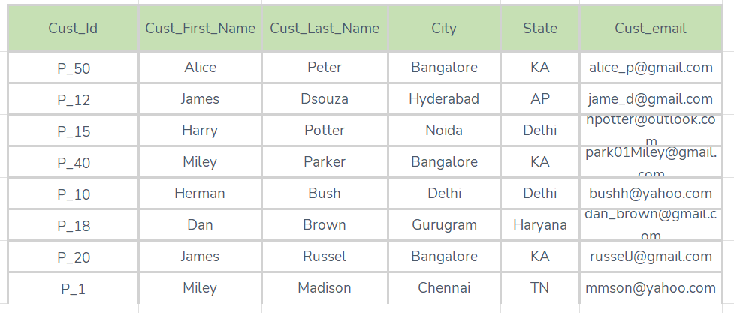
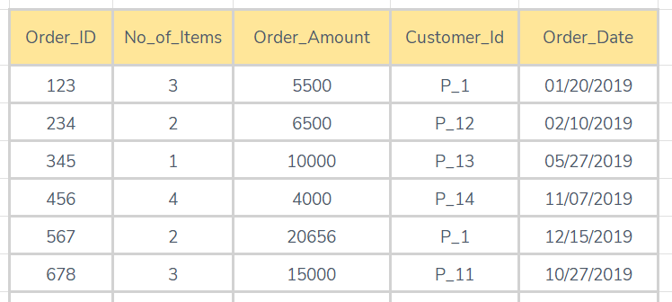
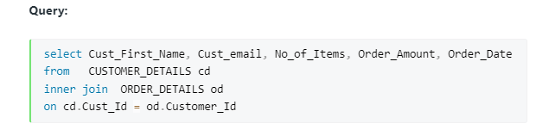
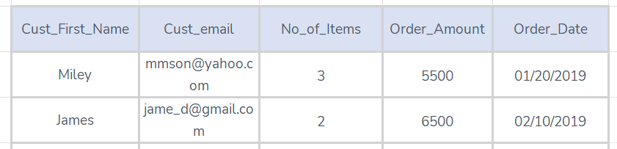
Order_Details
Customer_Details
Inner Join will give you only those records for which the condition is fulfilled.

Slide 37
2. Left Join
n left join, we select all the data from the left table and from the right table only select the data set which matches up with the condition mentioned with the join (here area 1+3)

Slide 38
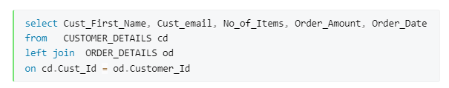
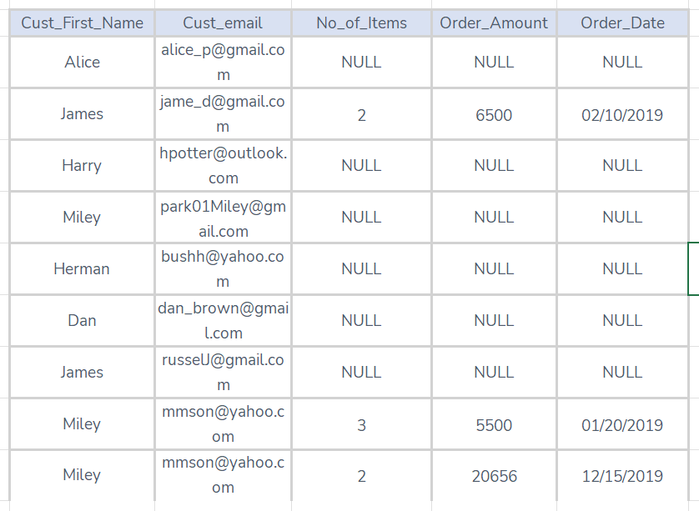
Order_Details
Customer_Details
Left Join will give you all the records from the left table i.e, the CUSTOMER_DETAILS table. If there are no orders placed by the customer it will return a null value for the columns in the ORDER_DETAILS table.

Slide 39
3. Right Join
In right join, we select all the data from the right table and from the left table only select the data set which matches up with the condition mentioned with the join (here 3+2)

Slide 40
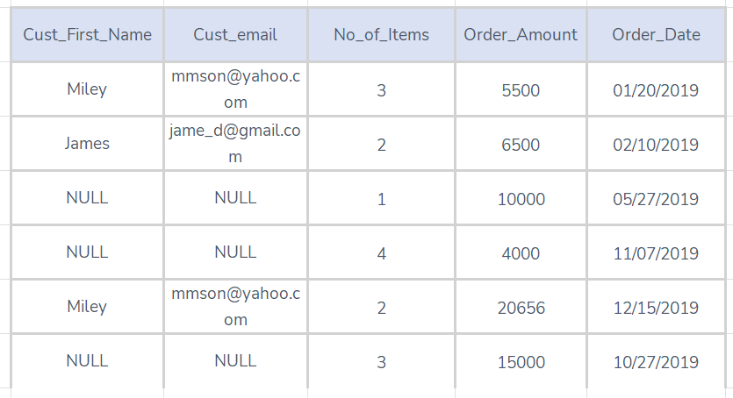
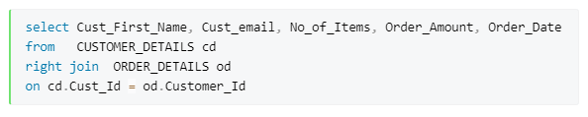
Order_Details
Customer_Details
Right, Join will give you all the records from the right table i.e, the ORDER_DETAILS table. If there are no customer records found for the order it will return a null value for the columns in the CUSTOMER_DETAILS table.

Slide 41
4. Full Join
In full join, all the records form both the tables are merged and selected irrespective of the condition mentioned with the join having met or not. (here 1+2+3)

Slide 42
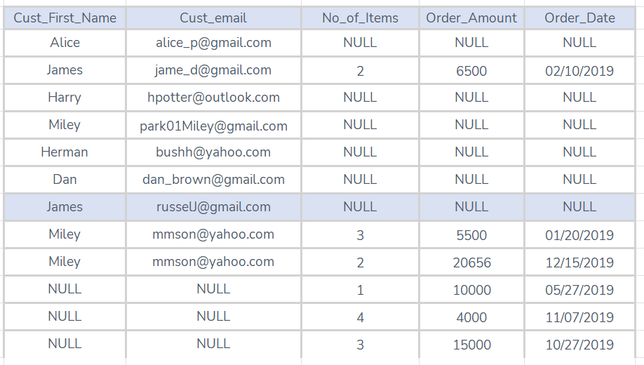
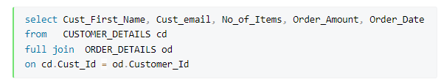
Order_Details
Customer_Details
Full Join will give you all the records specified from both the tables.

Slide 43

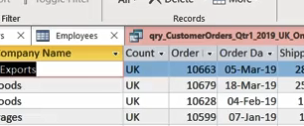
Lab 5A: Controlling Query Results with Join Types

Slide 44

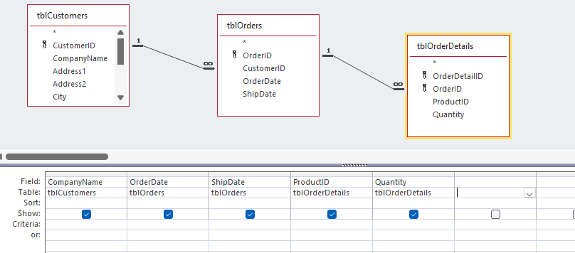
Lab 5A

Slide 45
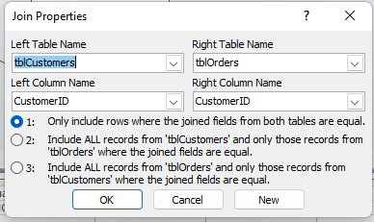
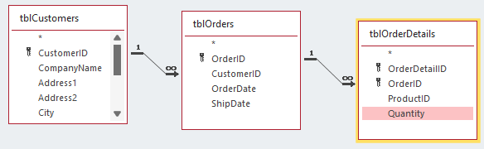
Lab 5A

Slide 46

Query Criteria

Slide 47
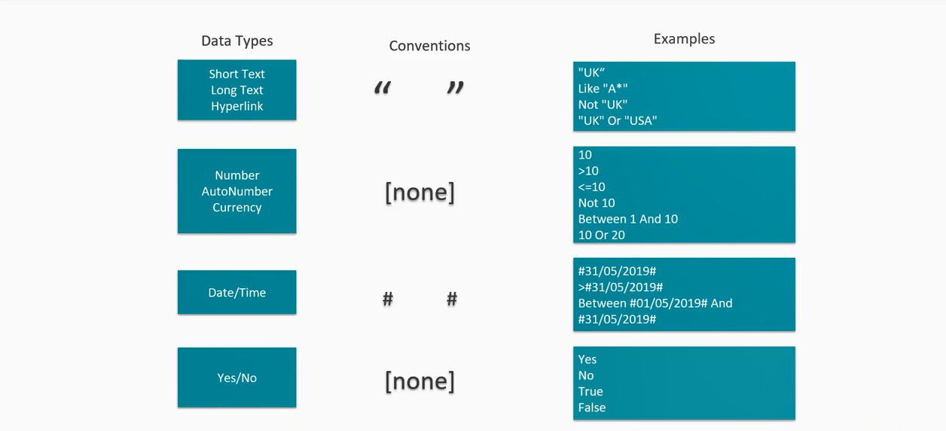
Data Types and Conventions

Slide 48
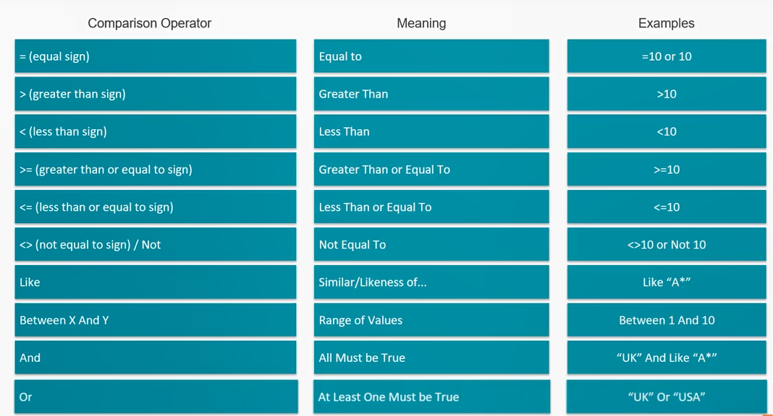
Logical Operators

Slide 49
Lab 5B: Creating Complex Queries with Multiple Criteria

Slide 50
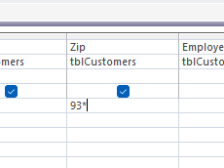
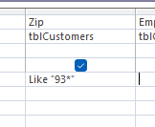
Lab 5B

Slide 51
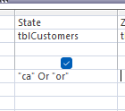
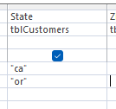
Lab 5B

Slide 52


Lab 5B

Slide 53


Ways to Write Expressions

Slide 54
Lab 5C: Calculating in Queries Using Expression Builder

Slide 55



Lab 5C

Slide 56


Lab 5C

Slide 57


Lab 5C

Slide 58


Lab 5C

Slide 59
Expression Syntax

Slide 60

Expression Examples

Slide 61

Expression Examples
Concatenation

Slide 62
Lab 5D: Concatenate Fields in Query

Slide 63


Lab 5D

Slide 64


Lab 5D

Slide 65

Lab 5D

Slide 66


Lab 5D

Slide 67


Lab 5D

Slide 68
Lab 5D

Slide 69
Lab 5E: Summarizing and Grouping Data Using Query

Slide 70

Lab 5E

Slide 71

Lab 5E

Slide 72

Lab 5E

Slide 73
WHERE and HAVING
SELECT Customers.[Company Name], Sum(Orders.[Order Amount]) AS [SumOfOrder Amount], Count(Orders.[Order Amount]) AS [CountOfOrder Amount], Countries.Country
FROM Countries INNER JOIN (Customers INNER JOIN Orders ON Customers.[Customer ID] = Orders.[Customer ID]) ON Countries.CountryID = Customers.Country
WHERE (((Year([Order Date]))=2015))
GROUP BY Customers.[Company Name], Countries.Country
HAVING (((Countries.Country)="UK"));

Slide 74
Lab 5F: Using Where and Having in Grouping

Slide 75

Lab 5F

Slide 76

Lab 5F

Slide 77

Lab 5F

Slide 78



Said Fawzy

